Slide 1
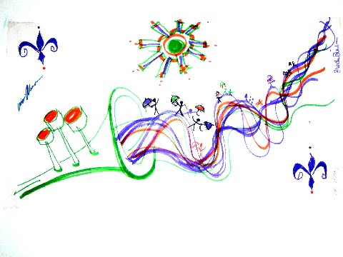
Group Interventions for Disaster/Trauma Anniversary Reactions Nemeth, D.¹, Kuriansky, J.² , Olivier, T.¹, Whittington, L.¹, May, N.¹, Hamilton, J.¹, Steger, A.¹ Neuropsychology Center of Louisiana, LLC ¹ and Columbia University ² Returning to Katrina - Bringing Hurricane Katrina Research Back to the Community University of Southern Mississippi – Center for Policy and Resilience Long Beach, Mississippi June 4-5, 2010

Slide 2
Abstract
According to Cameron (2000), “Tragedy or crisis is never purely economic, political, or military. It is always preeminently psychological.” Natural disasters such as Hurricanes Katrina and Rita, which devastated the Gulf Coast of the United States in the summer, 2005, have focused psychologists on the need to develop effective psychological post-trauma intervention strategies. Consistent with research, which shows that disaster survivors suffer particularly on anniversaries of the event, group wellness workshops were designed to help survivors cope on those occasions. Since disasters happen to groups of people, a group format was determined to be most appropriate one year post trauma. Anniversary reaction group workshops, focused on promoting wellness, were held to address unresolved emotional issues and to promote healing by encouraging belonging, comfort, security, and resilience. The ultimate goal of these wellness workshops was to assist participants in understanding and resolving their anniversary reactions.

Slide 3
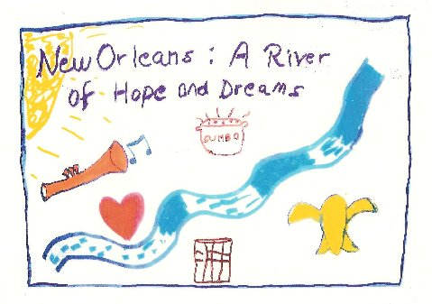
This workshop format, which was successfully utilized in China one year post Sichuan Earthquake trauma, with appropriate cultural modifications, allows participants to face their anniversary reactions, related psychological sequelae and physical displacement. Via group process, participants are able to find the emotional strength to reattach, form new communities, and begin problem-solving.
The purpose of this paper will be to present the qualitative and quantitative data from the fourth Hurricane Katrina Anniversary Wellness Workshop. Utilizing Spielberger’s State/Trait Anxiety Inventory (STAI), the quantitative data indicated a reduction in State Anxiety as a result of this seven hour intervention experience. Qualitative data indicated an increase in resiliency and community. All data are currently archived in the Katrina collection of the Cabildo, which is a Louisiana State Museum in New Orleans.
Abstract

Slide 4
Sponsoring Organizations
The World Council for Psychotherapy (WCP)
The Louisiana Spirit Hurricane Recovery Organization of the State of Louisiana Department of Health and Hospitals (DHH)
The Louisiana Group Psychotherapy Society (LGPS)
The Louisiana Psychological Association (LPA)
The Baton Rouge Area Society of Psychologists (BRASP)
The Baton Rouge General Medical Center
The Chapel on the Campus (Louisiana State University)
The Catholic Community Services of Baton Rouge
Staff at The Neuropsychology Center of Louisiana (NCLA)

Slide 5
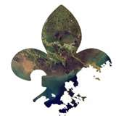
Hurricane Katrina
There once was a place I knew and loved
Then a hurricane named Katrina came from above
Our fortress crumbled under the pressure
The suffering would be far too great to measure
My life lay drowning in toxic water
My world was crumbling, falling farther and farther
Once the water subsided my life was not free
It was robbed of the memories that created what I call me
As I searched for the home I once resided
Comfort and security were no longer provided.
--Written in 2005 by Kristine King,
Doctoral student in psychology at
Virginia Tech University,
while a Clinical Assistant at
The Neuropsychology Center of Louisiana.

Slide 6
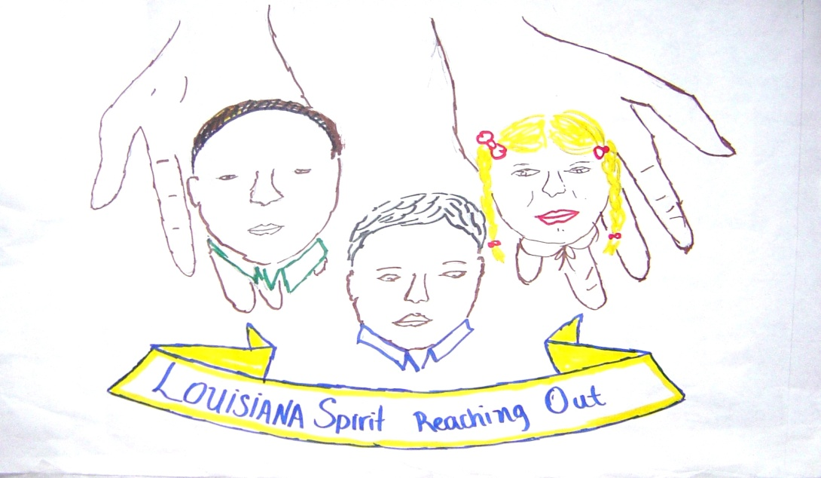
According to Cameron (2000),
“Tragedy or crisis is never purely economic, political, or military. It is always preeminently psychological.”

Slide 7
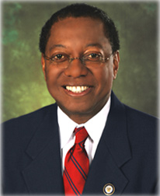
A Mayor’s Concern
In a television interview in the Spring of 2006, Mayor Melvin “Kip” Holden expressed concern about the emotional well-being of those individuals who were displaced to Baton Rouge by Hurricane Katrina. He suggested the need for intervention.

Slide 8
Anniversary Reaction
An anniversary reaction, which occurs on or around the date of a past traumatic event, involves reactions to an emotionally charged episode which holds tremendous significance for an individual or group.
When the initial event is experienced as traumatic, individuals may tend to become sensitized to re-experience the symptoms under reminiscent circumstances.
(Borstein & Clayton, 1972)

Slide 9
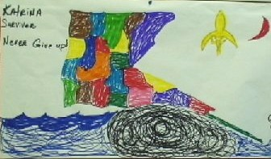
Specific Characteristics of Anniversary Reactions
Panic
Grief
Conflict

Slide 10
Characteristics in Common with Post Traumatic Stress Disorder (PTSD)
Intrusive memories
Emotional numbness
Reactivity
Reminders of the event
Sleep disturbance
Irritability
(Maccoll et al., 1999)

Slide 11
Psychological Sequelae
Depression
Anxiety
Substance
Abuse
(Bourque, Siegel, Kano, & Wood, 2006; Sattler et al., 2002)

Slide 12
The Most Vulnerable
Previous history of psychiatric illness
Proximity to and extent of exposure to the disaster
Concurrent personal issues
relocation
loss
poor social support
Poor coping skills
Low socio-economic status
Linguistic or social isolation
(Bourque et al., 2006; Tang, 2007)

Slide 13
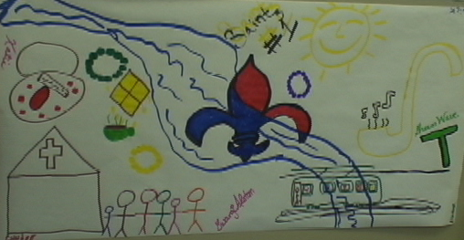
Secondary Stressors
Delayed resource
attainment
Crowding
Financial strain
Difficulty securing
employment
(Sattler et al., 2002)

Slide 14
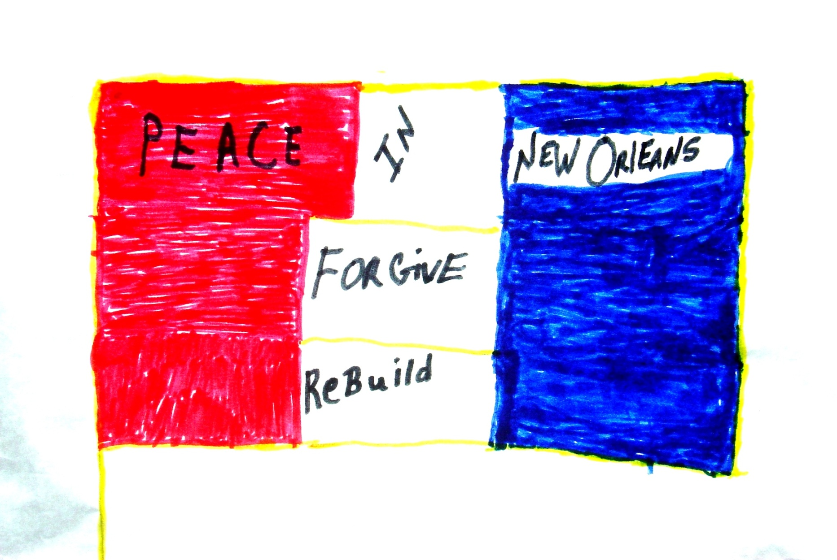
Why group intervention?
Safety
Validation
Reconnection
Reparative force
Prosocial effort
(Jordan, 2003)

Slide 15
Why Anniversary Wellness Workshops?
To address community disruption and immobilization *
To deal with memories that might be triggered on anniversary dates
To develop coping strategies for unresolved emotional issues
To deal with developmental regression that may have been caused by the environmental trauma
*(Tremblay, Blanchard, Pelletier, & Vallerand, 2006)

Slide 16
The Format
4 sessions:
Session 1 familiarized mental health professionals with the process
Sessions 2-4 offered psychological intervention for the re-emerging of traumatic experiences
The tripartite group process :
Didactic psychoeducational material presented in a group-as-a-whole format
Structured exercises conducted in small groups
A fish bowl group format summarized the small group experiences
Group-as-a-whole concluded and said goodbye

Slide 17
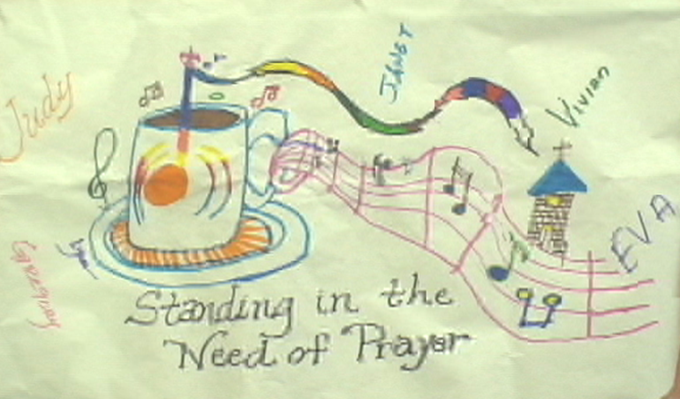
The Four Phases of Healing
Revisiting unresolved
developmental issues
Gaining a new
perspective
Choosing to belong
Accepting and
forgiving
(Nemeth, 2005)

Slide 18
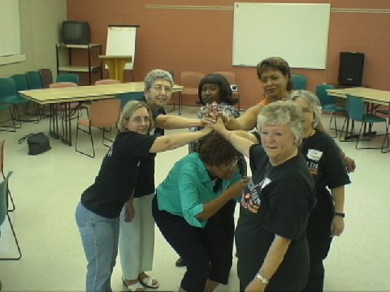
Balance

Slide 19
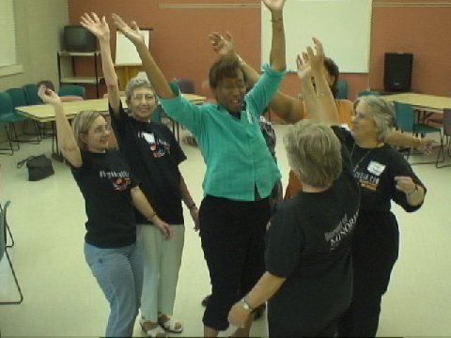
Chaos!

Slide 20
The Seven Exercises
My Good, Bad, and Ugly Hurricane Feelings
Relating in Love Every Evening (RILEE) Relaxation Exercise
Saying Goodbye to Say Hello
How I Feel
My Hurricane Feelings Banner
Our Banners
My New Banner

Slide 21
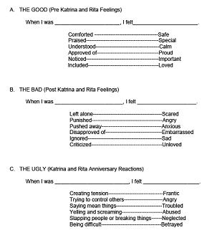
My Good, Bad, and Ugly Hurricane Feelings

Slide 22
Relating In Love Every Evening (RILEE)
Hi, let me introduce myself. I’m RILEE your friendly Relaxation Bear.
My name, RILEE, stands for Relating in Love Every Evening.
Since Katrina and Rita, this has
Become very hard to do.
Now, it is easier to feel alone and scared, than to feel comfortable and safe.
Sometimes we think we need our possessions to keep us comfortable.
But, look at me,
Bears don’t have any possessions.
Yet, I have found a way to keep myself comfortable.
Sometimes we think we need our house to keep us safe.
Yet, a house is not a home.
People, or, in my case a bear’s family, make a home.
Remember, home is where our hearts are and our hearts must be connected in love.
When we love and are loved we are safe.
When we are scared, we tend to disconnect, to be lost and afraid.
Then, we are not safe.
When we connect, we become safe once again.
Then we can find comfort.
Comfort can be found anywhere, you know.
Just as safety is a matter of the heart,
Comfort is a matter of the mind.
Both are gifts we give ourselves.
One by loving and connecting,
And the other by calming ourselves down and thinking good thoughts.
So, let’s practice together.
By taking care of myself and managing my worries and fears,
I can Relate in Love Every Evening and
I want to share these secrets with you.
This way you can feel comfortable and safe
Any time any place,
Just like me, RILEE Bear.

Slide 23
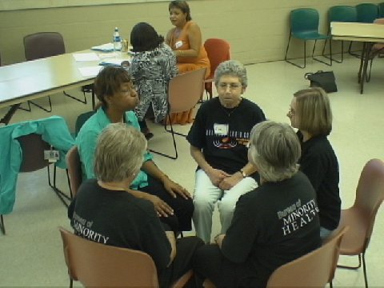
Relating In Love Every Evening (RILEE)

Slide 24
Saying Goodbye to Say Hello
How you say goodbye to the past often effects what happens next. You must say goodbye to the past in order to say hello to the future. This exercise has 4 parts…just like our Balance Table.
RESENTMENTS:
List 3 things that other people or agencies didn’t do right during or after the hurricane(s).
a)___________________________________________________________
b)___________________________________________________________
c)___________________________________________________________
REGRETS:
List 3 things that you didn’t do right during or after the hurricane(s).
a)___________________________________________________________
b)___________________________________________________________
c)___________________________________________________________
APPRECIATIONS:
List 3 things that you or other people or agencies did right during or after the hurricane(s).
a)__________________________________________________________
b)__________________________________________________________
c)__________________________________________________________
NEW BEGINNINGS:
List 3 lessons that you learned in order to move forward and say hello to your future.
a)__________________________________________________________
b)__________________________________________________________
c)__________________________________________________________

Slide 25
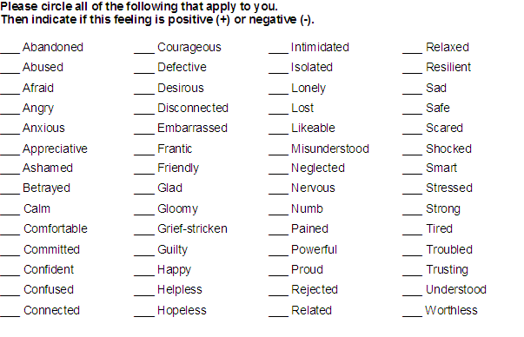
How I Feel

Slide 26
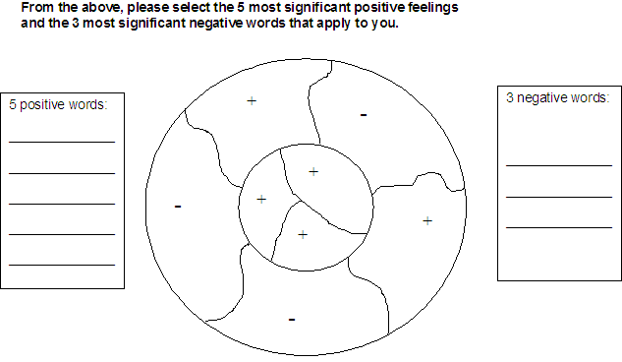
How I Feel

Slide 27
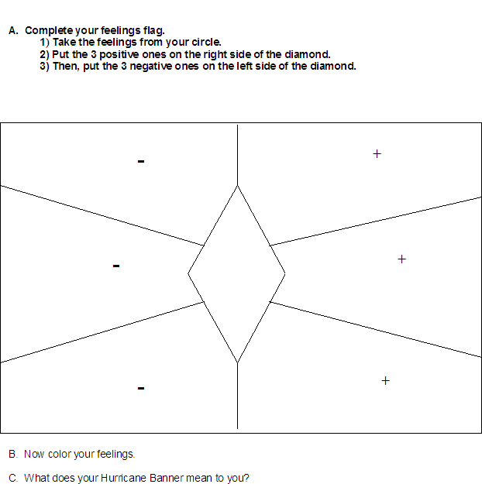
My Hurricane Feelings Banner

Slide 28
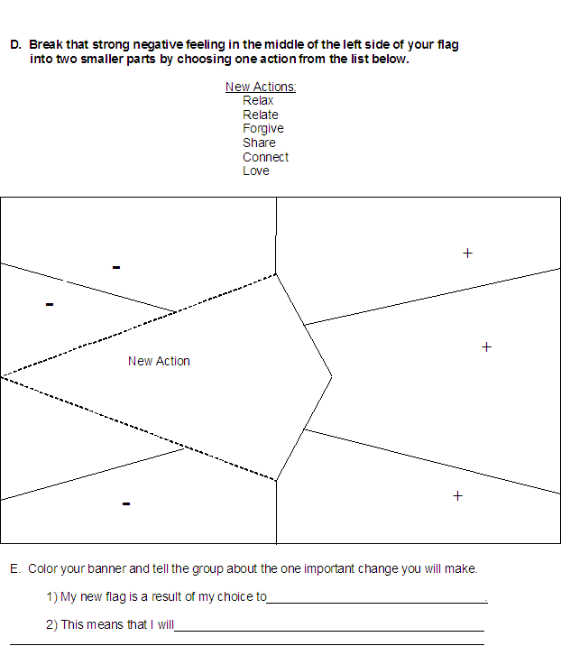
My New Hurricane Feelings Banner

Slide 29
What Banners Symbolize
Banners have been used for centuries to symbolize and announce who a person is. For example, a lion in a banner means strength, a cross means Christianity, three fleurs-de-lis symbolize New Orleans, etc. Now we use flags to symbolize our city, state, and country. For example, this is the Louisiana State Flag before Hurricane Katrina: During the 19th century it was traditional in Louisiana flags and the state seal for the "pelican in her piety" to have three drops of blood on her chest. However, over the years the tradition was forgotten.

Slide 30
Changing Banners
In 2006, after Hurricanes Katrina and Rita, Louisiana resumed the tradition. The Louisiana State flag now has three drops of blood added to the mother pelican's breast. Our communities have been forever changed by Hurricanes Katrina and Rita.

Slide 31
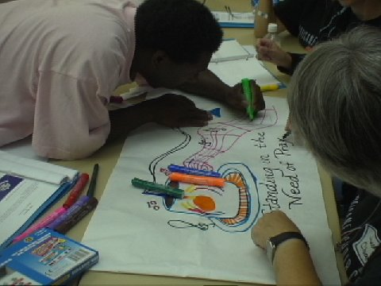
My New Banner
Because of the severity of those events, the state of Louisiana changed its flag to honor them. We invite you now to create your own rendition of a post-Katrina or Post-Rita flag for your community.

Slide 32
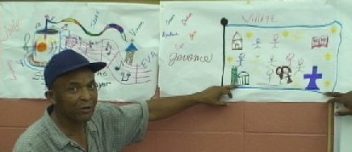
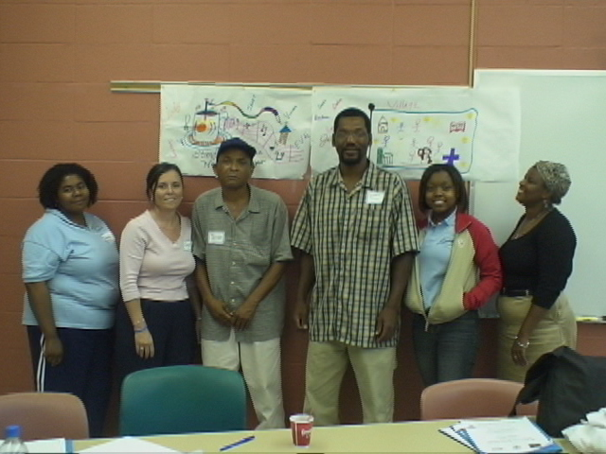
Our Group Banners

Slide 33
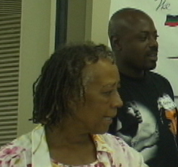
Anniversary Symptoms
Initial Assessment:
Constant Worry
Irritability
Tension
Headaches
Restlessness
Sleep disturbance
Sadness
Fatigue
(Nemeth, et al., 2010)

Slide 34
State-Trait Anxiety Inventory
Pre and Post Assessment:
STAI was completed by 16 participants before and after the 4th workshop to gather information related to their state and trait anxiety levels.
State – individual’s current anxiety
Trait - individual's typical anxiety
(Spielberger, C., 1977)

Slide 35
Hypotheses
Participants would report a significant reduction in anxiety following the workshop as measured by State questions
Participants would report no significant reduction in anxiety following the workshop as measured by Trait questions

Slide 36
Analyses
Reductions in State and Trait anxiety scores were each assessed with a separate repeated measure ANOVA
Alpha was .025

Slide 37
State Analysis
Reduction by 6.4 points was significant
[F(1,15) = 15.59, p < .001]
Confirms hypothesis that post-workshop state measures would significantly change from pre-workshop state measures

Slide 38
Trait Analysis
Reduction by 3.6 points was not significant
[F(1,15) = 2.30, p = .150]
Confirms hypothesis that post-workshop trait measures would not significantly change from pre-workshop trait measures

Slide 39
Qualitative Movement
From isolation to connection
From wary hostility to cooperation
From victimization to empowerment
Affirmation of the viability of group process as a healing force

Slide 40
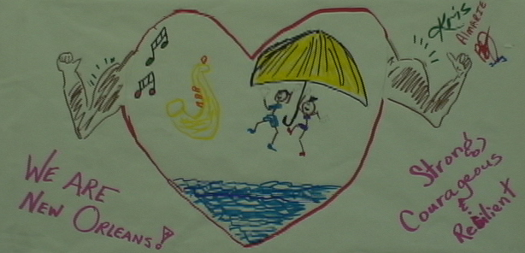
Discussion
The Container – Contained Model allowed:
A cognitive container (structure)
An affective freedom of expression in a contained (safe) environment
(Billow, 2003)

Slide 41
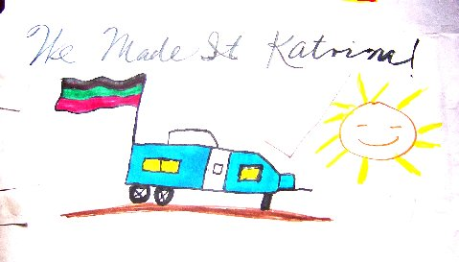
Discussion Cont’d.
Creative Group Process for:
Feeling
Thinking
Practicing
Relating
Doing

Slide 42
Discussion Cont’d.
What was experientially learned?
How thoughts and feelings were interrelated
Stress relieving techniques for coping
Deep breathing and relaxation strategies
Ways to combat negative thoughts or feelings
How to become proactive
How to reconnect

Slide 43
Discussion Cont’d.
What was accomplished?
A reduction of state anxiety
An increase in community attachment
An understanding of the power of “anniversary reactions”

Slide 44
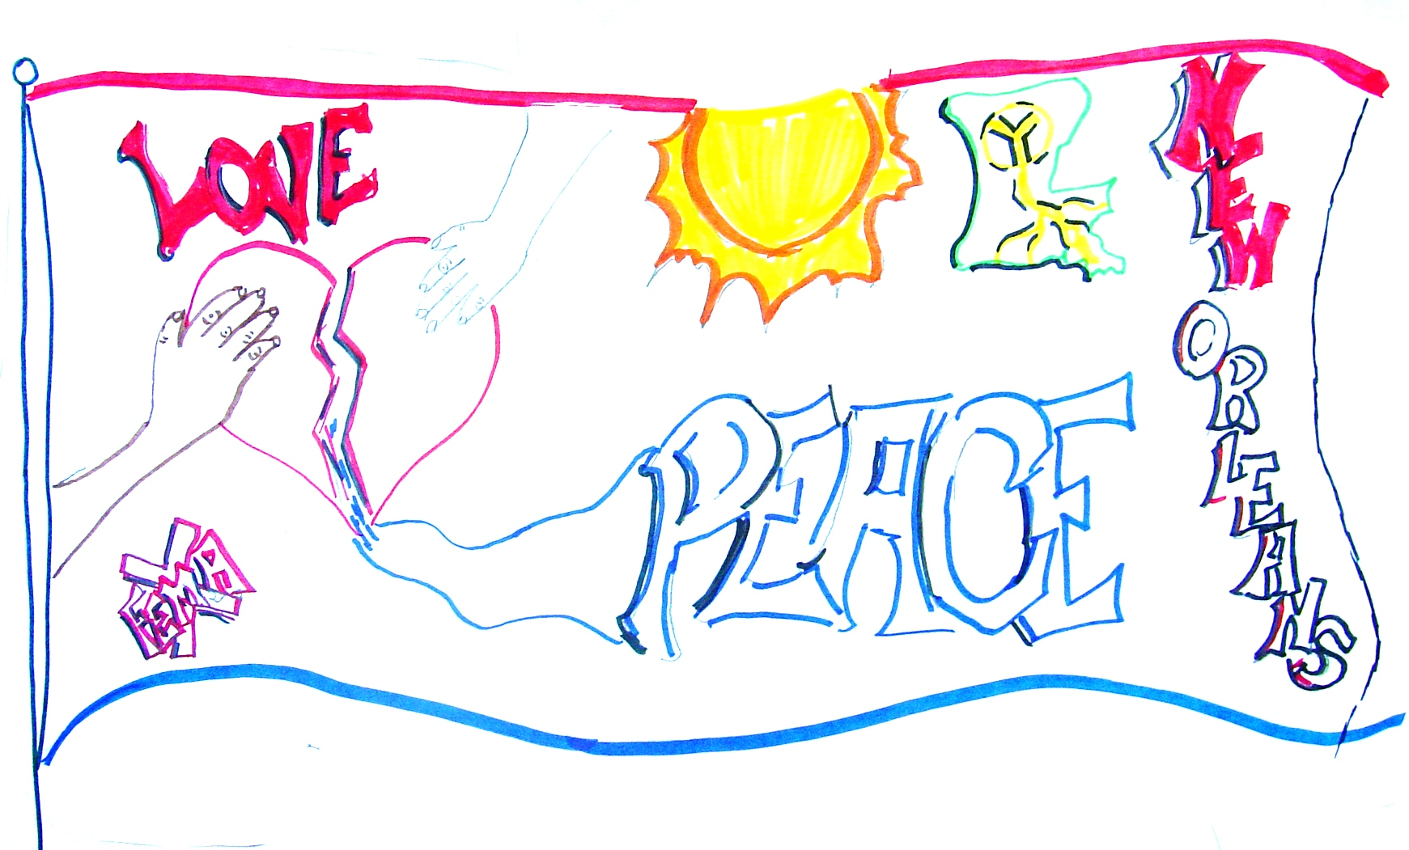
Discussion Cont’d.
The Legacy:
All workshop materials are now archived in the Hurricane Katrina collection of the Louisiana State Archives at the Cabildo in New Orleans

Slide 45
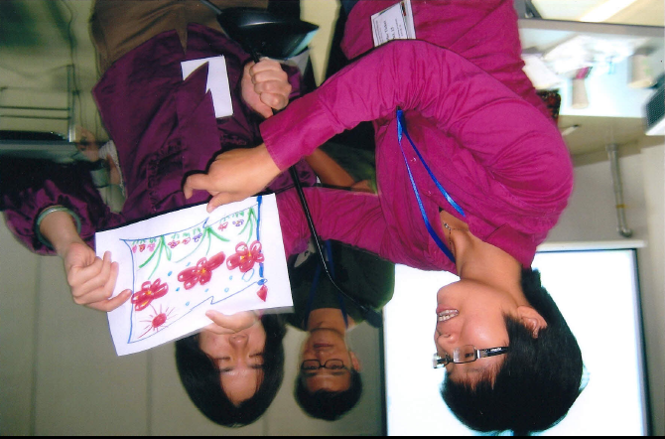
Discussion Cont’d.
Generalizability:
Drs. Nemeth and Kuriansky trained hundreds of Chinese mental health professionals in these workshop techniques
These methods were used to address the 2008 Sichuan Earthquake anniversary reactions

Slide 46
References
Billow, R.W. (2003). Relational group psychotherapy: From basic assumptions to passion. London: Jessica Kingsley Publishers.
Borstein, P.E., & Clayton, P. (1972). The anniversary reaction. Diseases of the Nervous System, 33, 470-472.
Bourque, L.B., Siegel, J.M., Kano, M., & Wood, M.M. (2006). Weathering the storm: The impact of hurricanes on physical and mental health. The Annals of the American Academy, 604, 129-151.
Jordan, K. (2003). What we learned from the 9/11 first anniversary. The Family Journal: Counseling and Therapy for Couples and Families, 11, 110-116.
Maccoll, M., Morgan, C.A., Hill, S., Fox, P., Kingham, P., & Southwick, S.M. (1999). Anniversary reaction in Gulf War veterans: A follow-up inquiry 6 years after the war. American Journal of Psychiatry, 156, 1075-1079.
Nemeth, D.G., Cameron, C., Creveling, C.C., Dreger, R.M., & Schexnayder, M.M. (2000, August). Outcome of millennium 2000: historical, technical, psychological, and research-based perspectives. Session presented at the the 108th Annual Convention of the American Psychological Association, Washington, DC.

Slide 47
Nemeth, D.G., Kuriansky, J., Reeder, K.P., Lewis, A., Marceaux, K., Whittington, T., Olivier, T.W., May, N.E., & Safier, J.A. Addressing anniversary reactions of trauma through group process: The hurricane Katrina anniversary wellness workshops. Manuscript accepted for publication by the International Journal of Group Psychotherapy on May 5, 2010.
Nemeth, D.G. (2005, September). Millennialism, terrorism, and the healing journey. Paper distributed at the 58th Annual United Nations Department of Public Information and Non-Governmental Organizations Conference, New York, New York.
Sattler, D.N., Preston, A.J., Kaiser, C.F., Olivera, V.E., Valdez, J., & Schlueter, S. (2002). Hurricane Georges: A cross-national study examining preparedness, resource loss, and psychological distress in the U.S. Virgin Islands, Puerto Rico, Dominican Republic, and the United States. Journal of Traumatic Stress, 15, 339-350.
Spielberger, C.D. (1983). State-trait anxiety inventory for adults. Redwood City, CA: Mind Garden.
Tang, C.S. (2007). Trajectory of traumatic stress symptoms in the aftermath of extreme natural disaster: A study of Thai survivors of the 2004 Southeast Asian Earthquake and Tsunami. The Journal of Nervous and Mental Disease, 195, 54-59.
Tremblay, M.A., Blanchard, C.M., Pelletier, L.G., & Vallerand, R.J. (2006). A dual route in explaining health outcomes in natural disaster. Journal of Applied Social Psychology, 26,1502-1522.

Slide 48
Correspondence
All correspondence should be directed to:
Darlyne G. Nemeth, Ph.D., M.P., A.B.M.P.
Clinical, Medical, and Neuropsychologist
Neuropsychology Center of Louisiana, LLC
4611 Bluebonnet Blvd., Ste. B
Baton Rouge, LA 70809
dgnemeth@gmail.com

